Slide 1

GOD-FIRST-JOHN-JAMES:THANK YOU JESUS CHRIST SON OF LIVING GOD<THANK YOU GOD OF THE UNIVERSE >
ABUNDANCE MARBLE :THANK YOU JESUS CHRIST SON OF LIVING GOD<THANK YOU GOD THE FATHER OF ALL NATIONS>
]
[
LIVE
SELFLESSLY
Memorise
Thou art worthy, O Lord, to receive glory and honour and power: for thou hast created all things, and for thy pleasure they are and were created.

Slide 2
Revelation 4:11
Read:
Genesis 50:15-21
VEAR
Bible in one year:
Judges 11-13
Hymn 23
Take My Life And Let It Be
Prayer Point:
Father, from today, please help me to live selflessly, in Jesus'name.

Slide 3
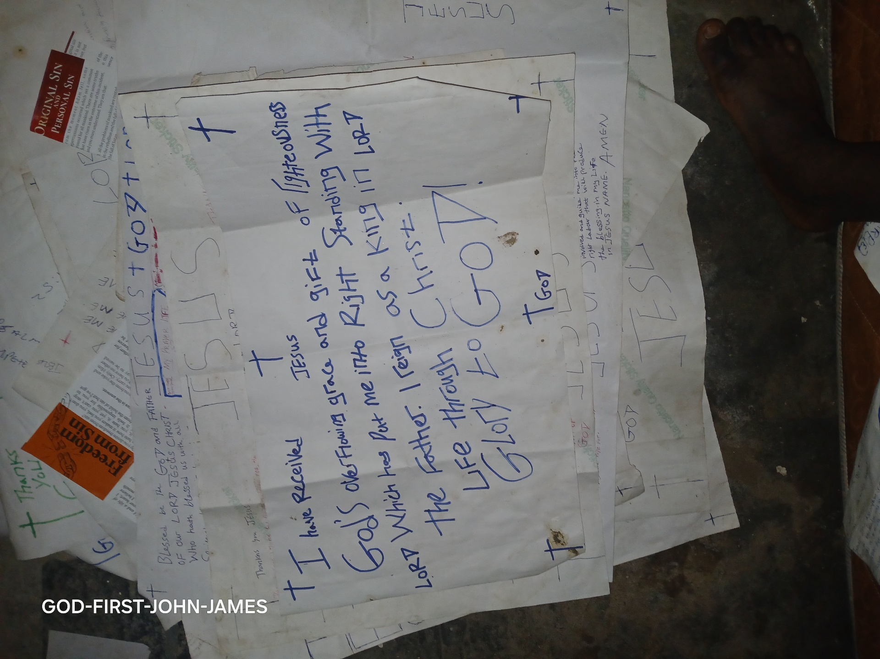
The twenty-four elders in heaven made it clear in T today's memory verse that we were created to fulfil God's pleasure. When we live for ourselves alone, we negate the purpose of our existence. When a person lives for God, he or she would not abuse any privilege or opportunity.
Joseph is a good example of someone who lived for and his fellow humar Even man beings, particularly his God his brothers. though they eventually repaid him with evil, his selfless service made him go the extra mile to find them and deliver their food to them when he couldn't locate them initially. He could have

Slide 4
returned home with the supplies he took with him, but he didn't. You can find the story in Genesis 37:13-28. Joseph's love for God caused him to reject the sexual advances of his master's wife. He could not bear doing anything that will displeased, and this made him say in Genesis 39:9:
There is none greater in this house than 1; neither hath he kept back any thing from me but thee, because thou art his wife: how then can I do this great wickedness, and sin against God?
Furthermore, his love for people made him interpret the dreams of his fellow inmates, which led to him becoming the Prime Minister of Egypt. When he eventually came into power, he did not consider the hardships he endured due to the cruelty of

Slide 5
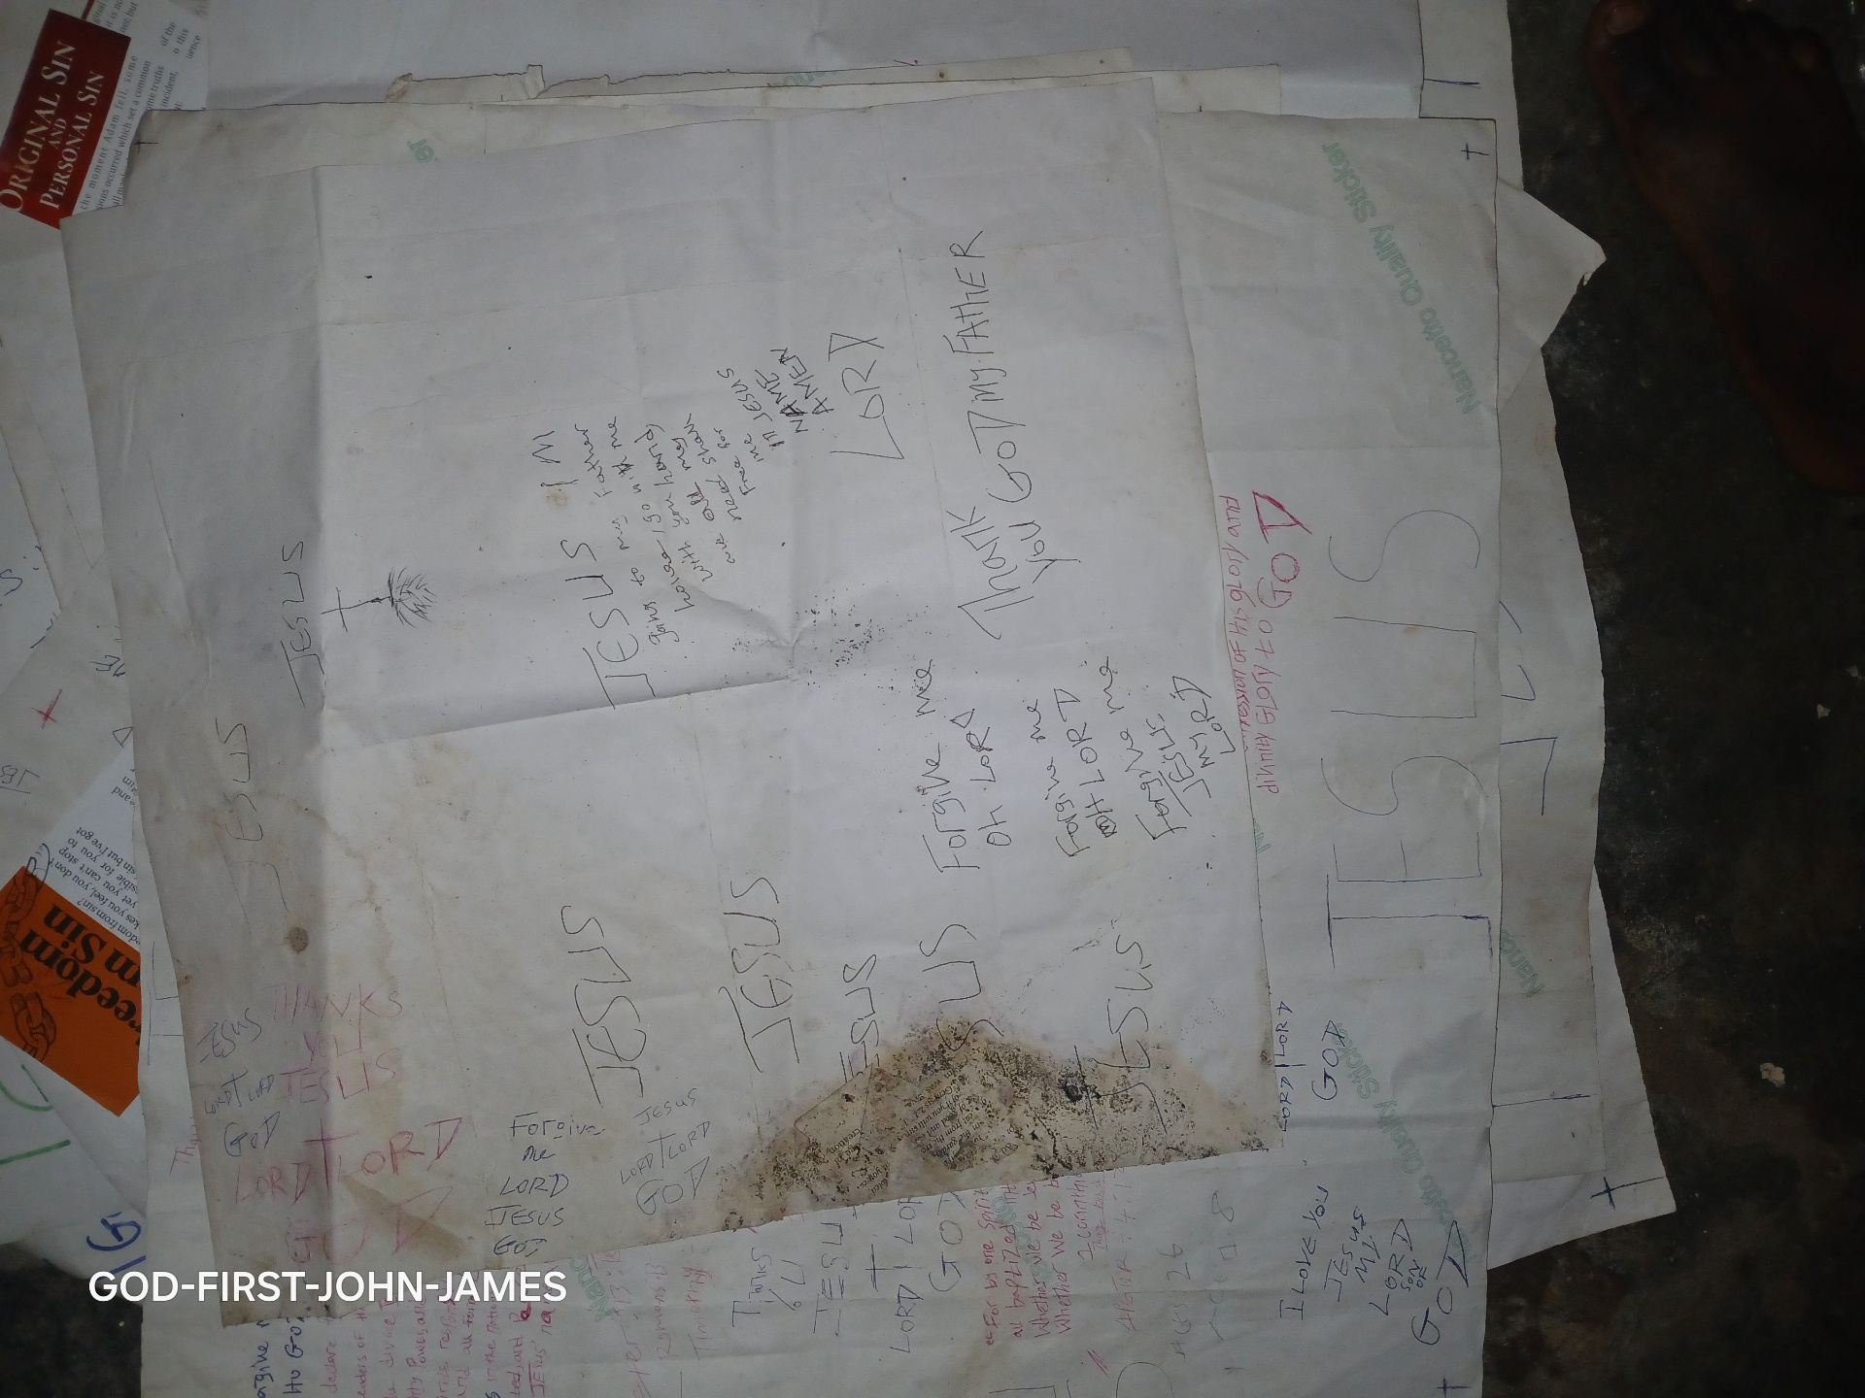
his brothers when they sold him into slavery. The love of God in him made him realise that his sufferings served a higher purpose for God and humanity. He said in Genesis 50:20:
But as for you, ye thought evil against me; but God meant it unto good, to bring to pass, as it is this day, to save much people alive.
Our Father in heaven wants us to live a selfless life so that we can attain the fullness of His purpose for our lives. Those who are selfish short-change themselves without knowing it.

Slide 6
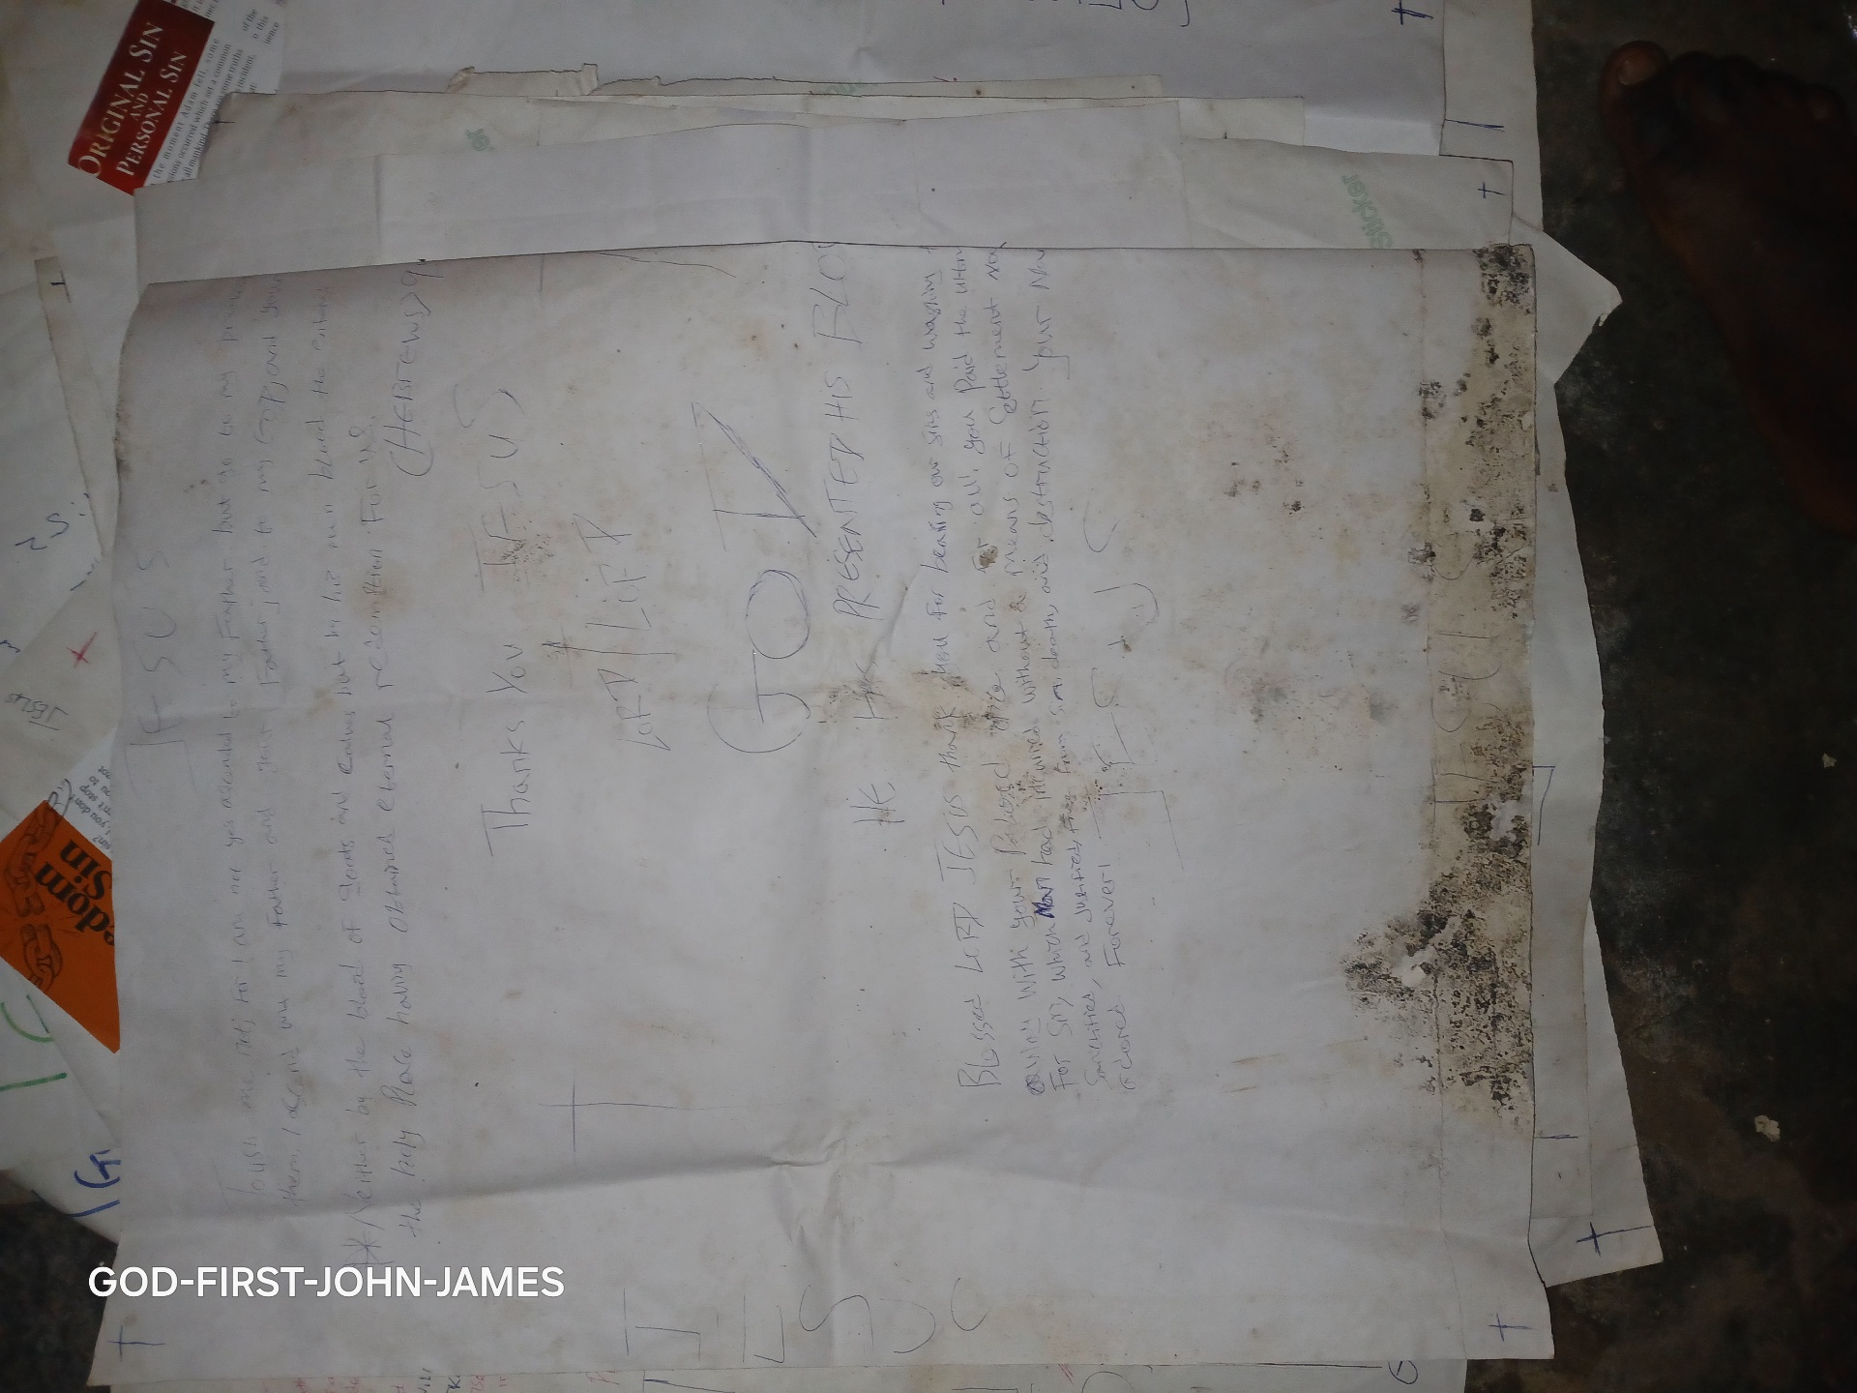
Moses, even though he lived in affluence in Pharoah's palace, decided to suffer with his brethren (the Israelites) and eventually saved them from bondage by leading them out of Egypt (Hebrews 11:24-27). His selflessness ensured that he fulfilled God's purpose for his life and the nation of Israel at large. Beloved, begin to live beyond yourself, and you will have the fullness of God's grace to divinely prosper, both spiritually and physically
]
[
THE MORE THE MERRIER
Memorise:

Slide 7
How should one chase a thousand, and two put ten thousand to flight, except their Rock had sold them, and the Lord had shut them up?
Deuteronomy 32:30
Read:
Ecclesiastes 4:9-12
BIBLE INA YEAR
Bible in one year:
Judges 9-10
Hymn 4
To The Work! To The Work! We Are Servants Of God

Slide 8
Action Point:
Make it a point of duty to preach the gospel to at least one person every day.
The more we are in our services will be. make a Our local assemblies, the merrier If we are not e a joyful noise? me the more we many, how can we are, the louder the merter it will be to noise we can make, and the mer together. Let me tell you that I believe to I yours woke up clapping. One day, the fine fingers sald singing, and they They tried to make a praise God be the origin of and heard the birds God, we also want to praise sound individually, but You. They triedenly, they are some sounds should e can produce So, it further, cooperate, maybe we finger cooperated with another finger, and they discovered

Slide 9
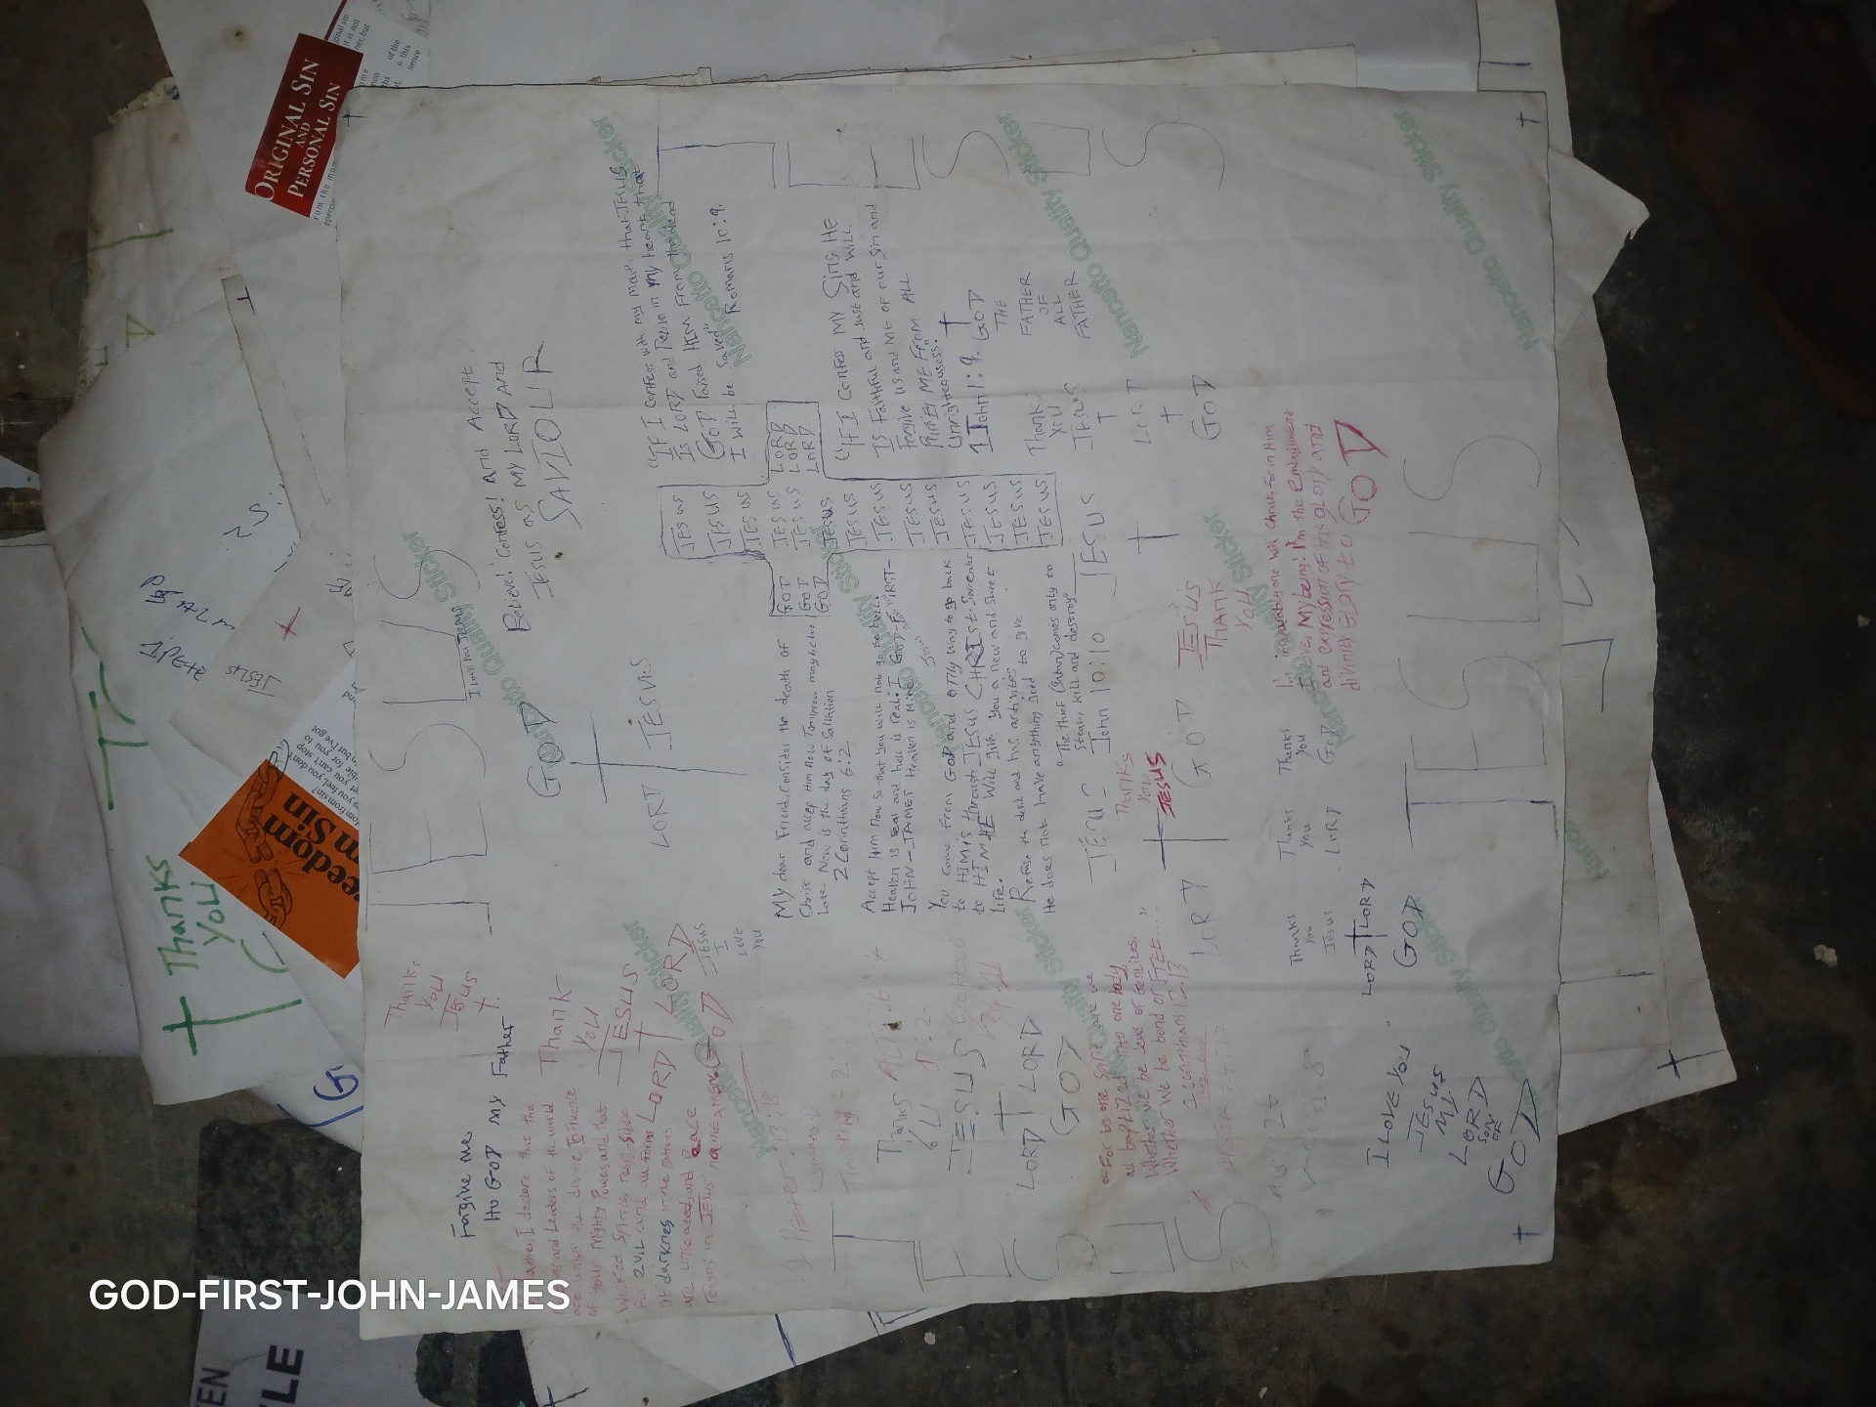
atentie snapping sound. They took it f that there was saloperated with the other palm. They made and der singer and then another finger decided to join in. one coope a better soundproved, and yet another finger joined in, Before long all the fingers were jamming together in praise, making a joyful noise to the LORD
In the same token, the more we are, the greater our impact will be in the world. When we are many, the impact we will make canot be ignored because it will be significant. When ten prople come together against a policy of the government, the government can easily ignore them. However when 10,000 people come together to speak against the same

Slide 10
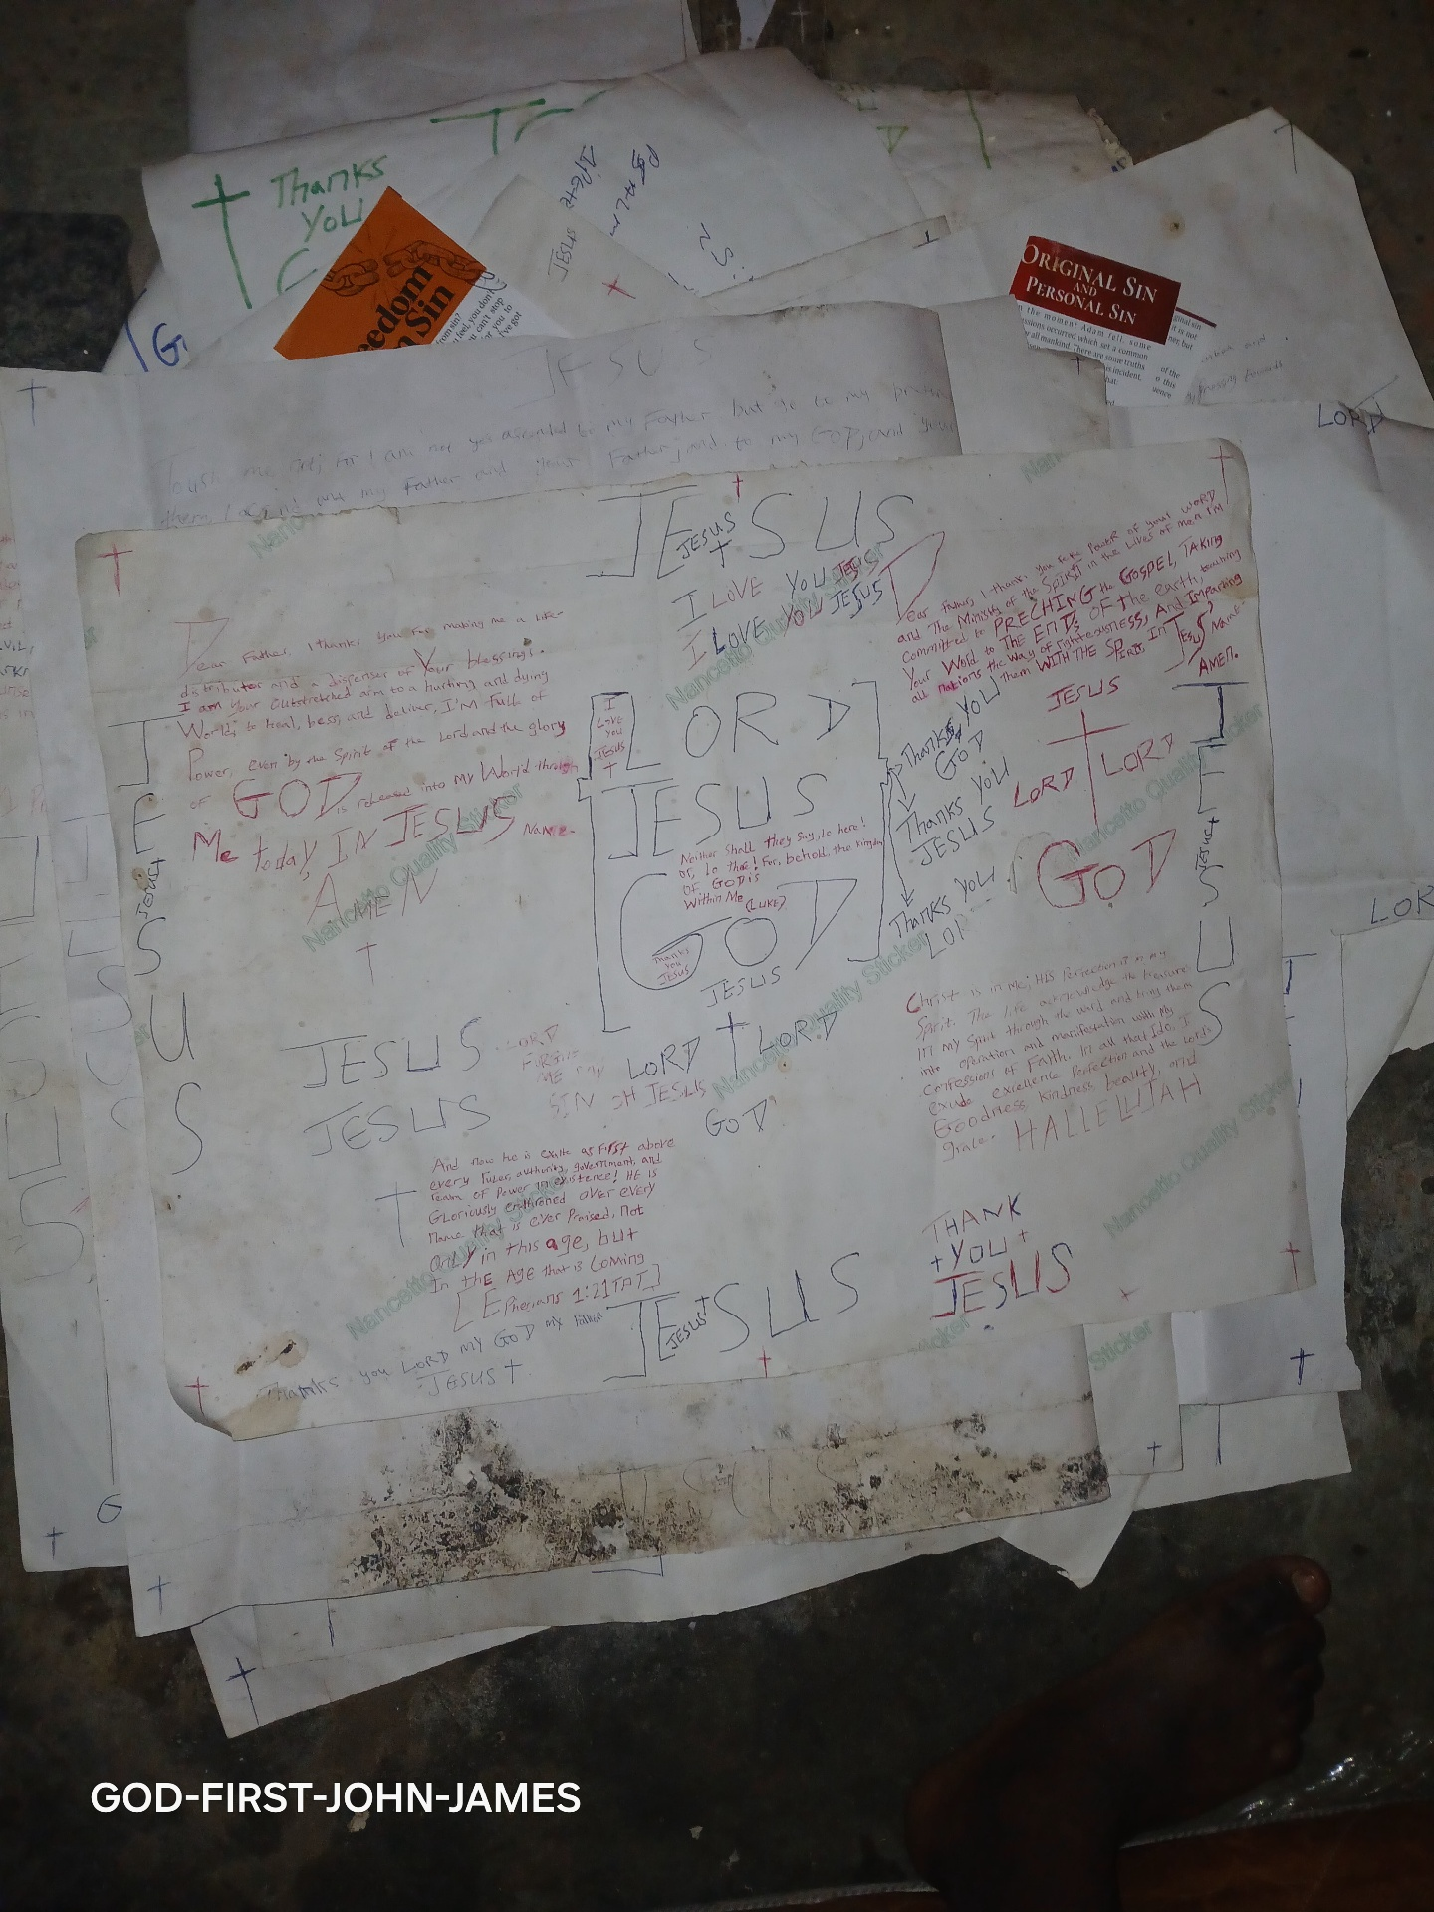
policy, it will be very difficult for the government to ignore them. The governing powers in the environment where your local assembly is situated will take you more seriously when you are many. As a result, your local assembly can influence the culture and policies in that environment.
When we are many, projects become easier to accomplish. When ten people come together to do something, they will have to put in a lot of effort and personal resources to get it done. However, if 100 people come together to do the same thing, they obviously will need less individual effort and personal resources to

Slide 11
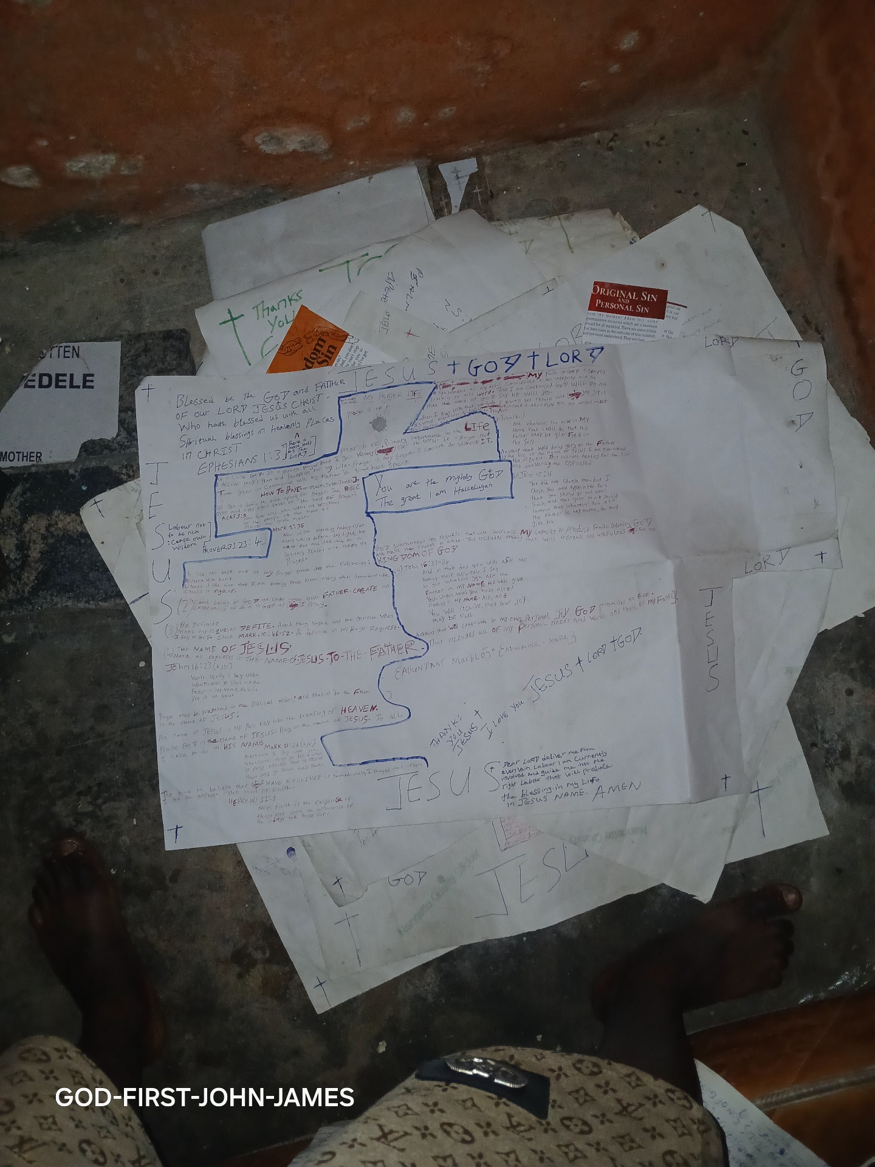
get that thing done. Therefore, projects are done faster and easier when we are many.
Beloved, if truly God is your father, you should be committed to the expansion of His kingdom. Preach the gospel anywhere you find yourself and set a personal target to win at least one soul to Christ per day. If you cannot go to the mission field, support missionaries with your prayers and your personal resources. The more Christians we have around the world, the greater our impact will be.
]
Thank you JESUS CHRIST SON OF LIVING GOD

Slide 12
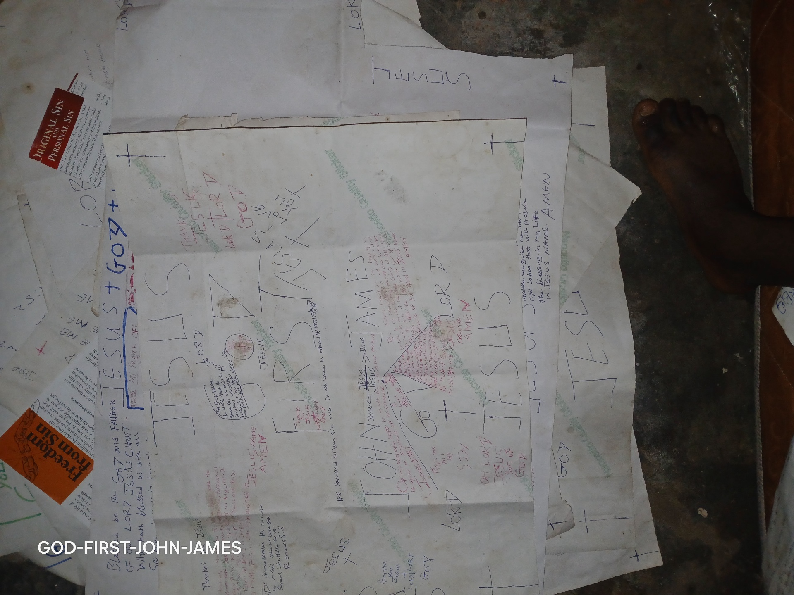
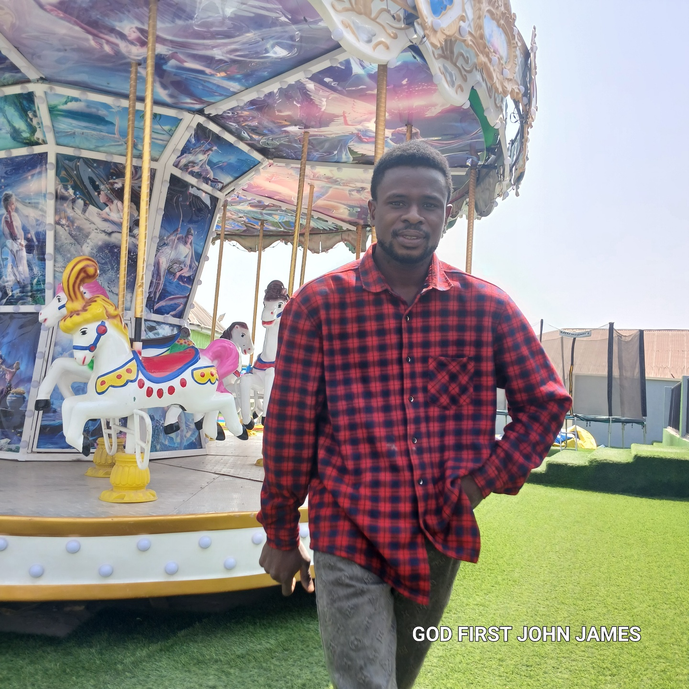

Slide 13
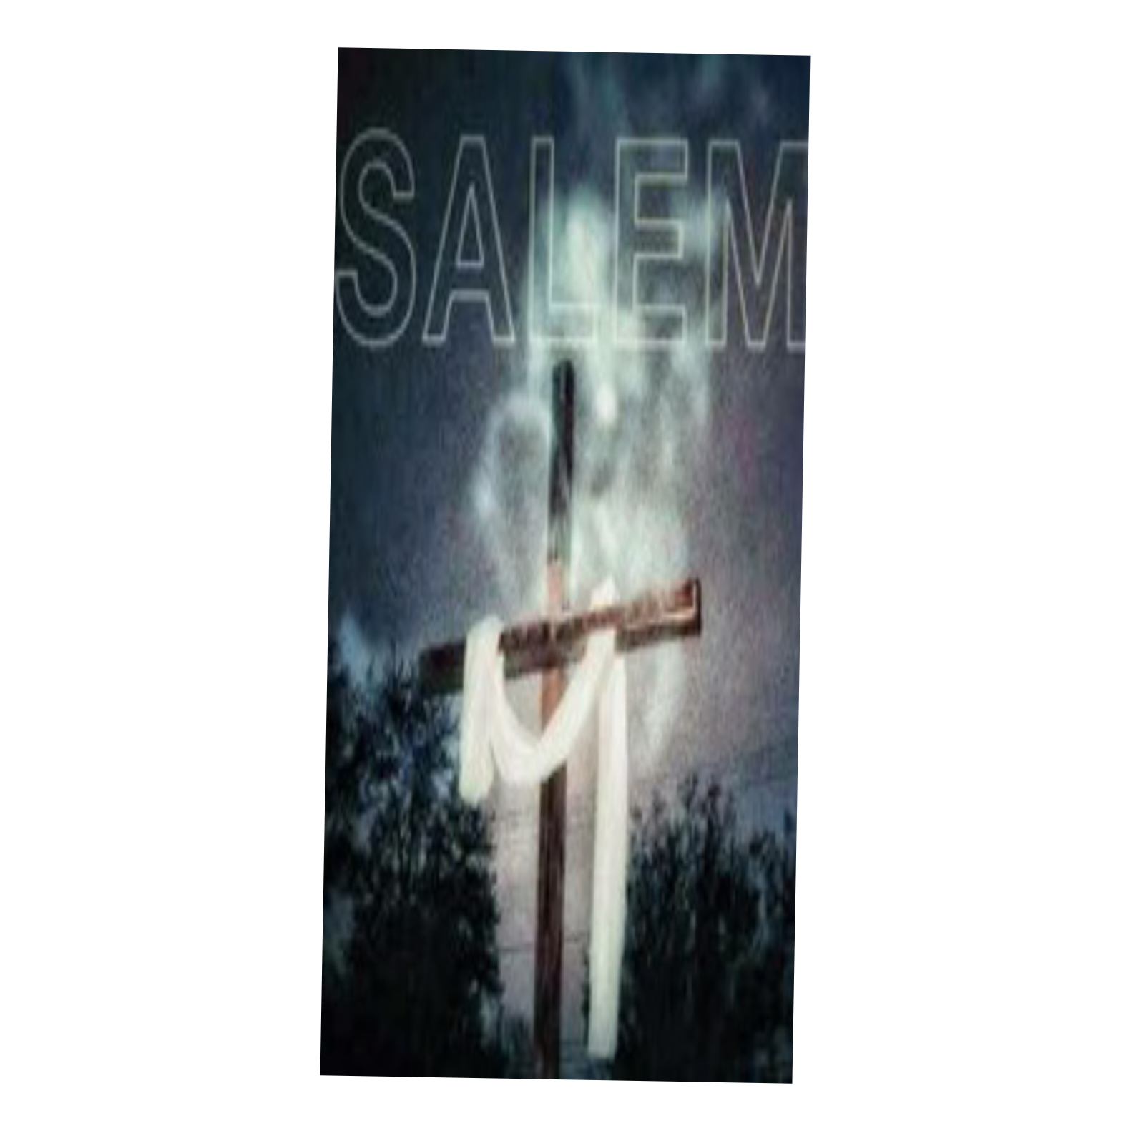

Slide 14
The LORD is my shepherd; I shall not want.
He maketh me to lie down in green pastures: he leadeth me beside the still waters.
He restoreth my soul: he leadeth me in the paths of righteousness for his name's sake.
Yea, though I walk through the valley of the shadow of death, I will fear no evil: for thou art with me; thy rod and thy staff they comfort me.
Thou preparest a table before me in the presence of mine enemies: thou anointest

Slide 15
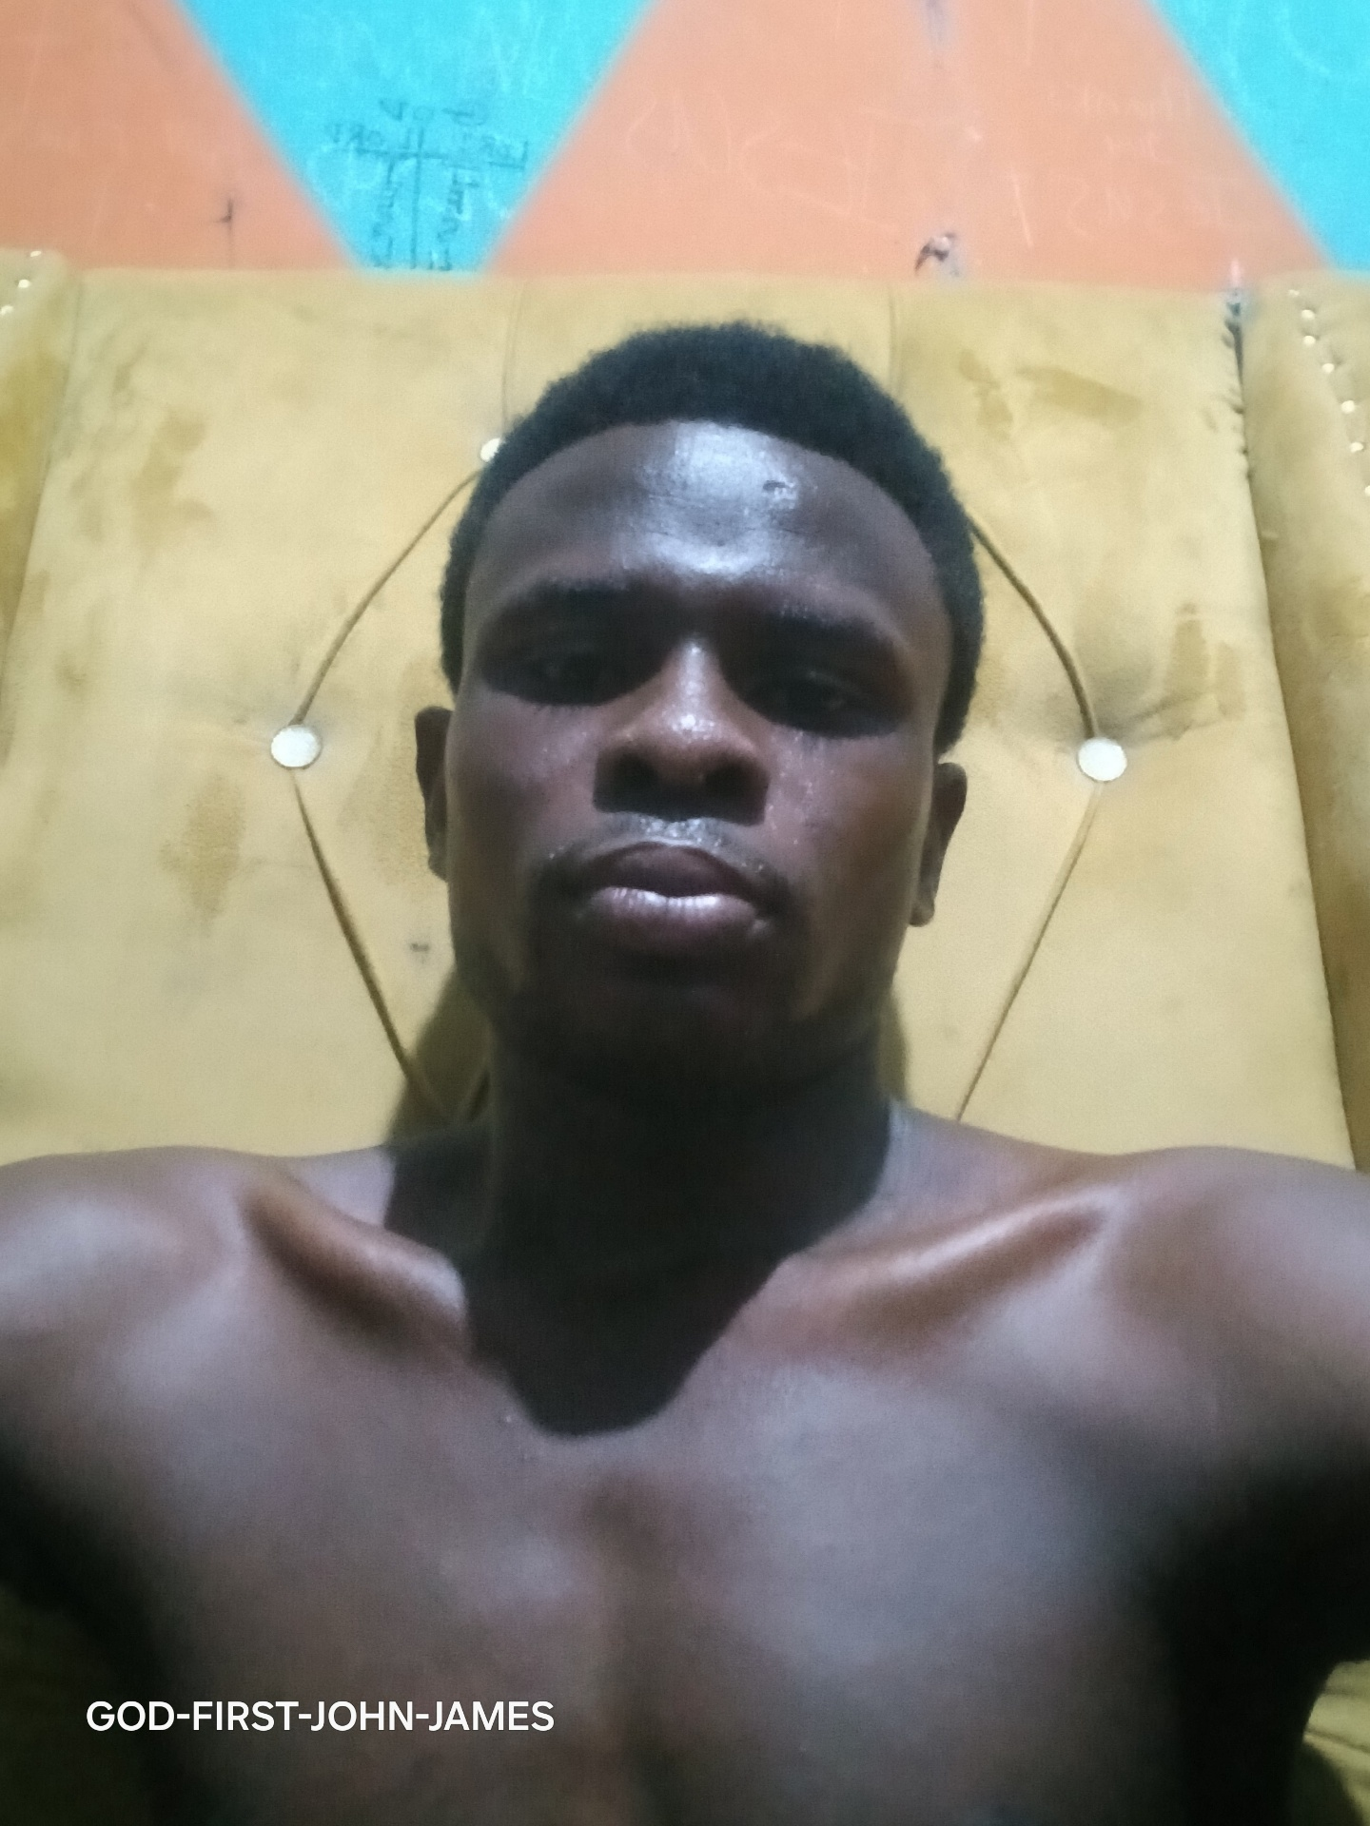
my head with oil; my cup runneth over.
Surely goodness and mercy shall follow me all the days of my life: and I will dwell in the house of the LORD for ever.
AMEN.

